Slide 1
How to teach intercultural curiosity using crossword puzzles
Duke, S.T. (2014). Preparing to study abroad: Learning to cross cultures. Stylus Publishing.

Slide 2
How to teach intercultural curiosity using crossword puzzles
Attitude of Intercultural Curiosity
Topic | Clue | Answer
1. Religious beliefs and the relationship of humans to the supernatural
2. Political power and the exercise of leadership in governance
3. Concepts of justice, fairness, punishment, and right conduct
4. Child raising and traditional processes of acculturation
5. Economic organization and division of labor
6. Rites of passage (life cycle celebrations), rituals, and ceremonies
7. Expression and style in the graphic and performing arts
8. Food preferences and rules concerning consumption
9. Nonverbal communication patterns and gestures
10. Concepts of humans’ place and role in the natural world
11. Myths and cultural heroes to explain and commemorate core values
12. Dissemination of ideas about beauty, love, truth, friendship, and loyalty
13. Notions of modesty and age-appropriate dress styles and behavior
14. Ideas of what time is and its relative importance
15. Concerns about individual versus collective privilege and responsibility
16. Definitions of gender and associated strengths, duties, and roles

Slide 3
How to teach intercultural curiosity using crossword puzzles
Attitude of Intercultural Curiosity
Topic | Clue | Answer
Religious beliefs and the relationship of humans to the supernatural | Religion whose symbol is a cross | Christianity
Political power and the exercise of leadership in governance | It is known as “the government of the people” | Democracy
Concepts of justice, fairness, punishment, and right conduct | A document that contains the laws and government principles | Constitution
Child raising and traditional processes of acculturation | A common sacrament for children that make them part of church | Baptism
Economic organization and division of labor | When products such as quinoa, avocado, maca, etc. are sent | Exportation
Rites of passage (life cycle celebrations), rituals, and ceremonies | A ceremony for women in their 15th birthday | Quinceañero
Expression and style in the graphic and performing arts | Traditional music popular in the central part of Peru | Huayno
Food preferences and rules concerning consumption | Ingredients (fruit, vegetables, etc.) that have been harvested | Fresh food
Nonverbal communication patterns and gestures | A movement of hands or fingers to make something move that way | Waggle
Concepts of humans’ place and role in the natural world | Many peasant follow it as a rule for receiving the earth benefits | Nature respect
Myths and cultural heroes to explain and commemorate core values | The first Incan emperor known as “The one who changed the Earth” | Pachacutec
Dissemination of ideas about beauty, love, truth, friendship, and loyalty | The electronic device used for watching any program | Television
Notions of modesty and age-appropriate dress styles and behavior | A kind of shorts for young men | Bermudas
Ideas of what time is and its relative importance | A popular way to call the delays | Peruvian time
Concerns about individual versus collective privilege and responsibility | If you are proud of something and tell everybody about it, you can be | Pretentious
Definitions of gender and associated strengths, duties, and roles | The person who sacrifices the most for the family | Mother

Slide 4
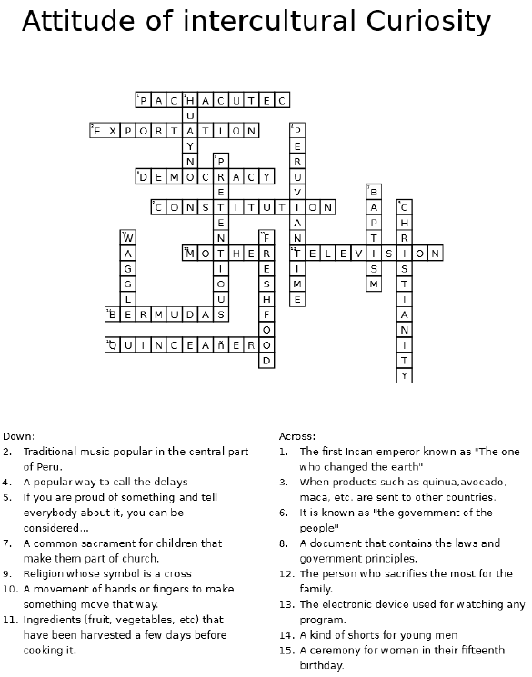

Slide 5
